Slide 1
Demand Paging
  Some slides and/or pictures are adapted from
  Operating System Concepts, 9th edition, by Silberschatz, Galvin, Gagne, John Wiley & Sons, 2013
  Lecture notes by Dr. Prof. John Kubiatowicz (Berkeley)

Slide 2
Virtual Memory vs. Physical Memory
So far, all of a job’s virtual address space must be in physical memory
However, many parts of programs are never accessed
  Unlikely error conditions
  Wasted malloc/new
  Large arrays
Processes don’t use all their memory all of the time
  90-10 rule: programs spend 90% of their time in 10% of their code
  Wasteful to require all of user’s code to be in memory
Large startup cost on a context switch
  Must load all of program into physical memory
  Limits degree of multiprogramming

Slide 3
Demand Paging:
Using Main Memory as a Cache for the Disk
Demand paging follows that pages should only be brought into memory if the executing process demands them.
Allow Virtual Memory > Physical Memory
  Many advantages
    Larger degree of multiprogramming
    Can write programs for large virtual memories
  Ex: on Sparc, 32 bit virtual addresses
    Can use 4GB of virtual address space
    Physical memory typically 16-64 MB
Warning: needs to be implemented efficiently

Slide 4
Page Fault ⇒ Demand Paging
Process
virtual address
physical address
instruction
MMU
page#
PT
frame#
retry
page fault
offset
exception
frame#
Operating System
offset
update PT entry
Page Fault Handler
load page from disk
scheduler

Slide 5
Demand Paging is Caching
Since Demand Paging is Caching, must ask:
  What is block size?
    1 page
  What is organization of this cache (i.e. direct-mapped, set-associative, fully-associative)?
    Fully associative: arbitrary virtual→physical mapping
  How do we find a page in the cache when look for it?
    First check TLB, then page-table traversal
  What is page replacement policy? (i.e. LRU, Random…)
    This requires more explanation… (kinda LRU)
  What happens on a miss?
    Go to lower level to fill miss (i.e. disk)
  What happens on a write? (write-through, write back)
    Definitely write-back. Need dirty bit!

Slide 6
Translating Virtual Addresses to Physical Addresses
Modify page table
  Add valid/invalid bit
Program still generate virtual addresses
  Now look up physical frame and check valid bit
  If invalid (“page fault”) means 1 of 2 things
    Address is illegal => kill of thread
    Address is legal but on disk => get it.

Slide 7

Page Table When Some Pages Are Not in Main Memory

Slide 8
What is in a Page Table Entry (PTE)?
What is in a Page Table Entry (or PTE)?
  Pointer to next-level page table or to actual page
  Permission bits: valid, read-only, read-write, write-only
Example: Intel x86 architecture PTE:
  Address same format previous slide (10, 10, 12-bit offset)
  Intermediate page tables called “Directories”
  P: Present (same as “valid” bit in other architectures)
  W: Writeable
  U: User accessible
  PWT: Page write transparent: external cache write-through
  PCD: Page cache disabled (page cannot be cached)
  A: Accessed: page has been accessed recently
  D: Dirty (PTE only): page has been modified recently
  L: L=1⇒4MB page (directory only).
  Bottom 22 bits of virtual address serve as offset
Page Frame Number
(Physical Page Number)
Free
(OS)
0
L
D
A
PCD
PWT
U
W
P
31-12
11-9
8
7
6
5
4
3
2
1
0

Slide 9
What happens on a page fault?
Trap to OS
  Get a free physical frame (may need to reclaim)
  If frame has been modified, schedule disk write
  Invalidate that address space’s page table entry
  Schedule disk read (note: takes long time)
  Update this address space’s page table entry
  Queue thread on disk queue
  Context switch to new thread
  (when disk read done move waiting thread to ready queue)

Slide 10

Steps in Handling a Page Fault

Slide 11
Demand Paging Cost Model
Since Demand Paging like caching, can compute average access time! (“Effective Access Time”)
  EAT = Hit Rate x Hit Time + Miss Rate x Miss Time
  EAT = Hit Time + Miss Rate x Miss Penalty
Example:
  Memory access time = 200 nanoseconds
  Average page-fault service time = 8 milliseconds
  Suppose p = Probability of miss, 1-p = Probably of hit
  Then, we can compute EAT as follows:
EAT = 200ns + p x 8 ms
= 200ns + p x 8,000,000ns
If one access out of 1,000 causes a page fault, then EAT = 8.2 μs:
  This is a slowdown by a factor of 40!
What if want slowdown by less than 10%?
  EAT < 200ns x 1.1 ⇒ p < 2.5 x 10⁻⁶
  This is about 1 page fault in 400,000!

Slide 12



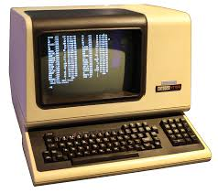
Origins of Demand Paging
Keep most of the address space on disk
Disks provide most of the storage
Actively swap pages to/from
Relatively small memory, for many processes
Keep memory full of the frequently accesses pages
P
Many clients on dumb terminals running different programs
. . .

Slide 13
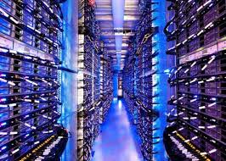
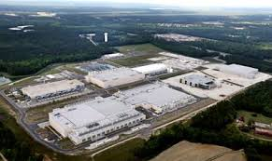




Very Different Situation Today
Powerful system
Huge memory
Huge disk
Single user

Slide 14
Many Uses of Virtual Memory and “Demand Paging” …
Extend the stack
  Allocate a page and zero it
Extend the heap
Process Fork
  Create a copy of the page table
  Entries refer to parent pages – NO-WRITE
  Shared read-only pages remain shared
  Copy page on write
Exec
  Only bring in parts of the binary in active use
  Do this on demand
MMAP to explicitly share region (or to access a file as RAM)

Slide 15
How does TLB affect things?
First check in TLB
If not there, trap to OS
OS checks its page tables
  If in memory, load page tables entry into TLB
  If not in memory, page fault

Slide 16
Aspects of Demand Paging
Extreme case – start process with no pages in memory
  OS sets instruction pointer to first instruction of process, non-memory-resident -> page fault
  And for every other process pages on first access
  Pure demand paging
Actually, a given instruction could access multiple pages -> multiple page faults
  Consider fetch and decode of instruction which adds 2 numbers from memory and stores result back to memory
  Pain decreased because of locality of reference
Hardware support needed for demand paging
  Page table with valid / invalid bit
  Secondary memory (swap device with swap space)
  Instruction restart

Slide 17
One detail left out: transparency
When faulting thread finally rescheduled:
  must restart instruction
    Instruction has never completed
  Hardware must save enough state
    What instruction was, complete state
    Same as info saved on regular context switch

Slide 18
Demand Paging Optimizations
Swap space I/O faster than file system I/O even if on the same device
  Swap allocated in larger chunks, less management needed than file system
Copy entire process image to swap space at process load time
  Then page in and out of swap space
  Used in older BSD Unix
Demand page in from program binary on disk, but discard rather than paging out when freeing frame
  Used in Solaris and current BSD
  Still need to write to swap space
    Pages not associated with a file (like stack and heap) – anonymous memory
    Pages modified in memory but not yet written back to the file system

Slide 19
Copy-on-Write
Copy-on-Write (COW) allows both parent and child processes to initially share the same pages in memory
  If either process modifies a shared page, only then is the page copied
COW allows more efficient process creation as only modified pages are copied
vfork() variation on fork() system call has parent suspend and child using copy-on-write address space of parent
  Designed to have child call exec()
  Very efficient

Slide 20

Before Process 1 Modifies Page C

Slide 21

After Process 1 Modifies Page C

Slide 22
What Happens if There is no Free Frame?
Used up by process pages
Also in demand from the kernel, I/O buffers, etc
How much to allocate to each?
Page replacement – find some page in memory, but not really in use, page it out
  Algorithm – terminate? swap out? replace the page?
  Performance – want an algorithm which will result in minimum number of page faults
Same page may be brought into memory several times

Slide 23

Need For Page Replacement

Slide 24
Basic Page Replacement
Find the location of the desired page on disk
Find a free frame:
- If there is a free frame, use it
- If there is no free frame, use a page replacement algorithm to select a victim frame
- Write victim frame to disk if dirty
Bring the desired page into the (newly) free frame; update the page and frame tables
Continue the process by restarting the instruction that caused the trap

Slide 25

Page Replacement

Slide 26
What Factors Lead to Misses?
Compulsory Misses:
  Pages that have never been paged into memory before
  How might we remove these misses?
    Prefetching: loading them into memory before needed
    Need to predict future somehow! More later.
Capacity Misses:
  Not enough memory. Must somehow increase size.
  Can we do this?
    One option: Increase amount of DRAM (not quick fix!)
    Another option: If multiple processes in memory: adjust percentage of memory allocated to each one!
Conflict Misses:
  Technically, conflict misses don’t exist in virtual memory, since it is a “fully-associative” cache
Policy Misses:
  Caused when pages were in memory, but kicked out prematurely because of the replacement policy
  How to fix? Better replacement policy

Slide 27
Page and Frame Replacement Algorithms
Frame-allocation algorithm determines
  How many frames to give each process
  Which frames to replace
Page-replacement algorithm
  Want lowest page-fault rate on both first access and re-access
Evaluate algorithm by running it on a particular string of memory references (reference string) and computing the number of page faults on that string
  String is just page numbers, not full addresses
  Repeated access to the same page does not cause a page fault
  Results depend on number of frames available
In all our examples, the reference string of referenced page numbers is
7,0,1,2,0,3,0,4,2,3,0,3,0,3,2,1,2,0,1,7,0,1

Slide 28

Graph of Page Faults Versus The Number of Frames

Slide 29

First-In-First-Out (FIFO) Algorithm
Reference string: 7,0,1,2,0,3,0,4,2,3,0,3,0,3,2,1,2,0,1,7,0,1
3 frames (3 pages can be in memory at a time per process)
Can vary by reference string: consider 1,2,3,4,1,2,5,1,2,3,4,5
  Adding more frames can cause more page faults!
    Belady’s Anomaly
How to track ages of pages?
  Just use a FIFO queue
15 page faults

Slide 30
1,2,3,4,1,2,5,1,2,3,4,5

Slide 31

FIFO Illustrating Belady’s Anomaly

Slide 32

Optimal Algorithm: MIN (minimum)
Replace page that will not be used for longest period of time
  9 is optimal for the example
How do you know this?
  Can’t read the future
Used for measuring how well your algorithm performs

Slide 33

Least Recently Used (LRU) Algorithm
Use past knowledge rather than future
Replace page that has not been used in the most amount of time
Associate time of last use with each page
12 faults – better than FIFO but worse than MIN
Generally good algorithm and frequently used
But how to implement?

Slide 34
LRU Algorithm (Cont.)
Stack implementation
  Keep a stack of page numbers in a double link form:
  Page referenced:
    move it to the top
    requires 6 pointers to be changed
  But each update more expensive
  No search for replacement
LRU and MIN are cases of stack algorithms that don’t have Belady’s Anomaly
      Contents of memory with N frames is subset of contents of memory with N+1 frame

Slide 35

Use Of A Stack to Record Most Recent Page References

Slide 36
LRU Approximation Algorithms
LRU needs special hardware and still slow
Reference bit
  With each page associate a bit, initially = 0
  When page is referenced bit set to 1
  Replace any with reference bit = 0 (if one exists)
    We do not know the order, however
Second-chance algorithm
  Generally FIFO, plus hardware-provided reference bit
  Clock replacement
  If page to be replaced has
    Reference bit = 0 -> replace it
    reference bit = 1 then:
      set reference bit 0, leave page in memory
      replace next page, subject to same rules

Slide 37
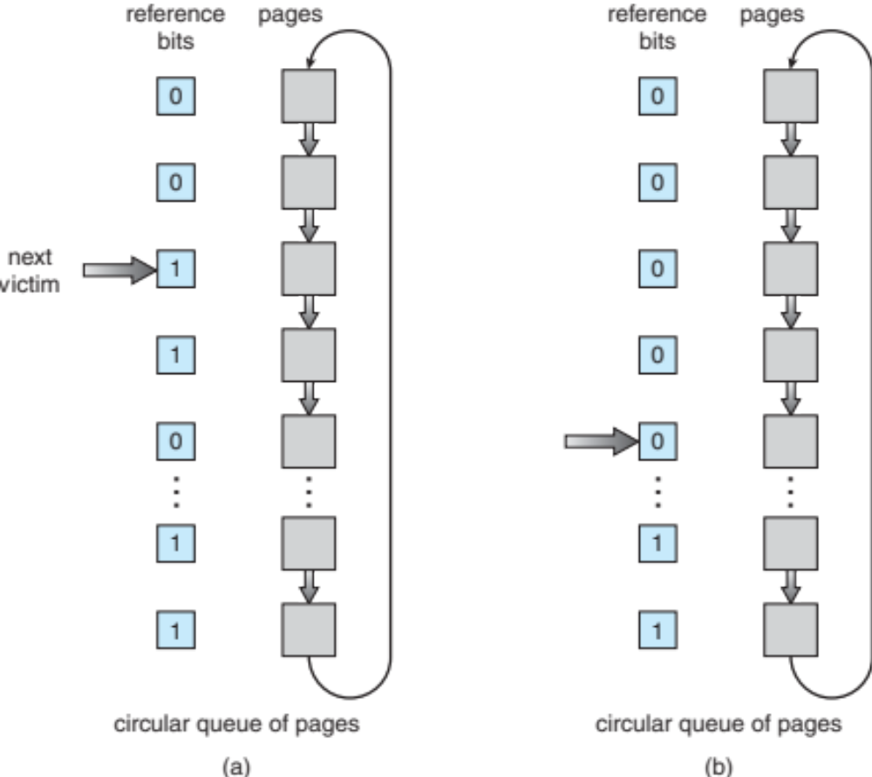
Second-Chance (clock) Page-Replacement Algorithm

Slide 38
Enhanced Second-Chance Algorithm
Improve algorithm by using reference bit and modify bit (if available) in concert
Take ordered pair (reference, modify)
(0, 0) neither recently used not modified – best page to replace
(0, 1) not recently used but modified – not quite as good, must write out before replacement
(1, 0) recently used but clean – probably will be used again soon
(1, 1) recently used and modified – probably will be used again soon and need to write out before replacement
When page replacement called for, use the clock scheme but use the four classes replace page in lowest non-empty class
  Might need to search circular queue several times

Slide 39
Advanced Paging Issues
Swap Area
Transparency
Core Map
Global vs. Local Replacement
Thrashing
Prepaging.

Slide 40
Swap Area
“Swap Space” – special area on disk
  Dedicated to holding an entire address space
    One swap file per address space
  Limits size of virtual memory
  Managed differently than rest of disk
    Know where data will go; can make disk access very fast

Slide 41
More on Transparency
Executing an instruction has several steps
  Instruction Fetch
  Instruction Decode
  Execute
Page fault can happen at fetch or execute
  So in general, just restart whole instruction
Block copies are a problem, as is autoincrement

Slide 42

Instruction Restart
Consider an instruction that could access several different locations
  block move
  auto increment/decrement location
  Restart the whole operation?
    What if source and destination overlap?

Slide 43
Recall: Core Map
Maps physical frame to virtual page
Very useful in page replacement
  Just scan through each frame
  Wouldn’t want to go through every single address space, because could be many
  What about sharing?
    One physical frame can be used by several address spaces

Slide 44
Global vs. Local Replacement
Should OS reclaim
  Most appropriate frame being used by the faulting address space? (“local replacement”)
  Most appropriate frame in memory? (“global replacement”)
Better throughput with global replacement
One hog can ruin everything, however.

Slide 45
Thrashing
Pages replaced when still needed
  Thread can spend more time page faulting than getting any useful work done
Very common on timesharing systems
  Ex: log more and more users into the system, eventually:
  total # of pages needed > total # of pages available
Adding more processes can actually decrease CPU utilization
Need to figure out needs of a process

Slide 46

Thrashing (Cont.)

Slide 47

Working-Set Model
Working Set (Denning, MIT, mid-60’s)
  Informally, collection of pages process is using right now
Δ ≡ working-set window ≡ a fixed number of page references
WSS_{i} (working set of Process P_{i}) = total number of pages referenced in the most recent Δ (varies in time)
D = Σ WSS_{i} ≡ total demand frames, approximation of locality
if D > m (the total number of physical frames) ⇒ Thrashing
Policy if D > m, then suspend or swap out one of the processes

Slide 48

Working Sets and Page Fault Rates
Direct relationship between working set of a process and its page-fault rate
Working set changes over time
Peaks and valleys over time

Slide 49

Page-Fault Frequency
More direct approach than WSS
Establish “acceptable” page-fault frequency (PFF) rate and use local replacement policy
  If actual rate too low, process loses frame
  If actual rate too high, process gains frame

Slide 50
What about Compulsory Misses?
Recall that compulsory misses are misses that occur the first time that a page is seen
  Pages that are touched for the first time
  Pages that are touched after process is swapped out/swapped back in
Clustering:
  On a page-fault, bring in multiple pages “around” the faulting page
  Since efficiency of disk reads increases with sequential reads, makes sense to read several sequential pages
Working Set Tracking:
  Use algorithm to try to track working set of application
  When swapping process back in, swap in working set

Slide 51
Program Structure
  Writing stupid programs => slow execution
  int[128,128] data;
  Each row is stored in one page
  Program 1
for (j = 0; j <128; j++)
for (i = 0; i < 128; i++)
data[i,j] = 0;
  128 x 128 = 16,384 page faults
  Program 2
  for (i = 0; i < 128; i++)
  for (j = 0; j < 128; j++)
  data[i,j] = 0;
  128 page faults

Slide 52




Linux Virtual Memory Map (Pre-Meltdown)
0xFFFFFFFF
0xFFFFFFFFFFFFFFFF
Kernel
Addresses
Kernel
Addresses
896MB
Physical
64 TiB
Physical
0xC0000000
User
Addresses
0xFFFF800000000000
Empty
Space
“Canonical Hole”
0x00007FFFFFFFFFFF
User
Addresses
0x00000000
0x0000000000000000
32-Bit Virtual Address Space
64-Bit Virtual Address Space

Slide 53
Pre-Meltdown Virtual Map (Details)
Kernel memory not generally visible to user
  Exception: special VDSO (virtual dynamically linked shared objects) facility that maps kernel code into user space to aid in system calls (and to provide certain actual system calls such as gettimeofday())
Every physical page described by a “page” structure
  Collected together in lower physical memory
  Can be accessed in kernel virtual space
For 32-bit virtual memory architectures:
  When physical memory < 896MB
    All physical memory mapped at 0xC0000000
  When physical memory >= 896MB
    Not all physical memory mapped in kernel space all the time
    Can be temporarily mapped with addresses > 0xCC000000
For 64-bit virtual memory architectures:
  All physical memory mapped above 0xFFFF800000000000

Slide 54
Post Meltdown Memory Map
Meltdown flaw (2018, Intel x86, IBM Power, ARM)
  Exploit speculative execution to observe contents of kernel memory
  1: // Set up side channel (array flushed from cache)
  2: uchar array[256 * 4096];
  3: flush(array); // Make sure array out of cache
  4: try { // … catch and ignore SIGSEGV (illegal access)
  5: uchar result = *(uchar *)kernel_address; // Try access!
  6: uchar dummy = array[result * 4096]; // leak info!
  7: } catch(){;} // Could use signal() and setjmp/longjmp
  8: // scan through 256 array slots to determine which loaded
  Some details:
    Reason we skip 4096 for each value: avoid hardware cache prefetch
    Note that value detected by fact that one cache line is loaded
    Catch and ignore page fault: set signal handler for SIGSEGV, can use setjump/longjmp….
Patch: Need different page tables for user and kernel
  Without PCID tag in TLB, flush TLB twice on syscall (800% overhead!)
  Need at least Linux v 4.14 which utilizes PCID tag in new hardware to avoid flushing when change address space
Fix: better hardware without timing side-channels
  Will be coming, but still in works

Slide 55
Summary
Demand paging follows that pages should only be brought into memory if the executing process demands them.
Replacement policies
  FIFO: Place pages on queue, replace page at end
  MIN: Replace page that will be used farthest in future
  LRU: Replace page used farthest in past
Clock Algorithm: Approximation to LRU
  Arrange all pages in circular list
  Sweep through them, marking as not “in use”
  If page not “in use” for one pass, then can replace
Working Set:
  Set of pages touched by a process recently
Thrashing: a process is busy swapping pages in and out
  Process will thrash if working set doesn’t fit in memory
  Need to swap out a process

